Slide 1
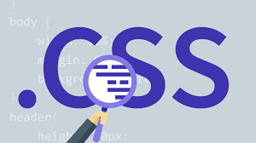

Slide 2
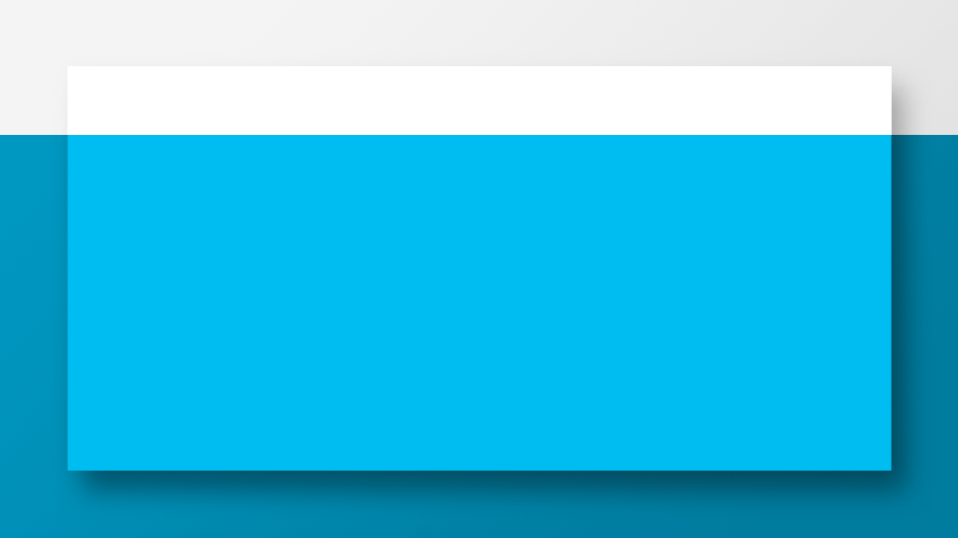
Css Positions
“The Position property can help you manipulate the location of an element, also specifies the type of positioning method used for an element.”
Different position values:
i- Static
Ii- Relative
Iii- Absolute
Iv- Fixed

Slide 3
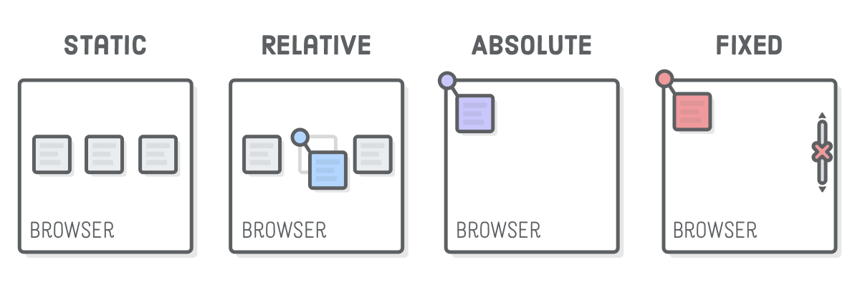
Position

Slide 4
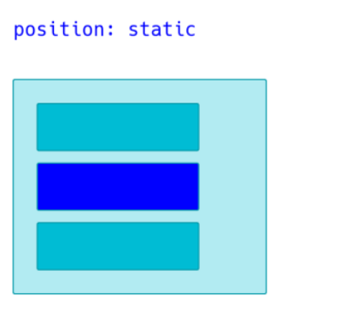
Static
›HTML elements are positioned static by default.
Static positioned elements are not affected by the top, bottom, left, and right properties.

Slide 5
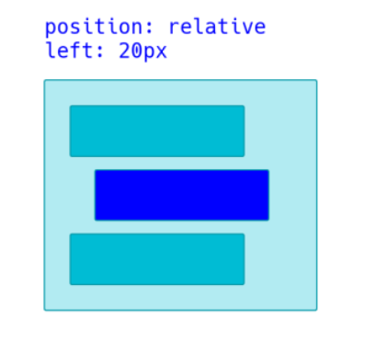
Relative
›An element’s original position remains in the flow of the document, just like the Static But now left/right/top/bottom/z-index will work.

Slide 6
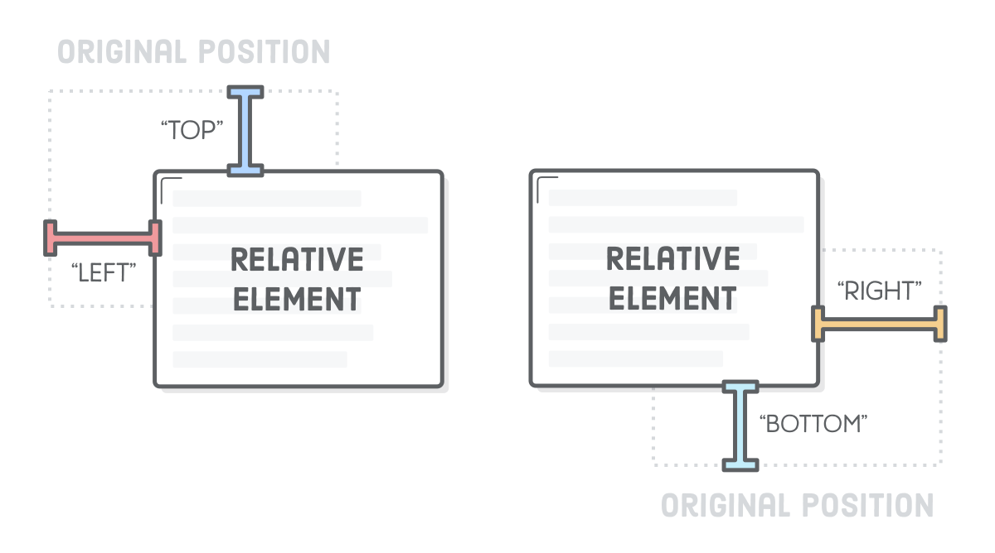
Relative

Slide 7
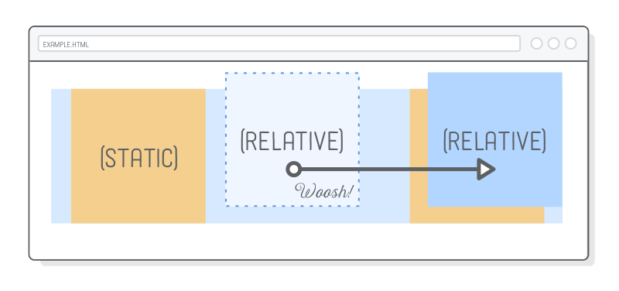
Relative

Slide 8
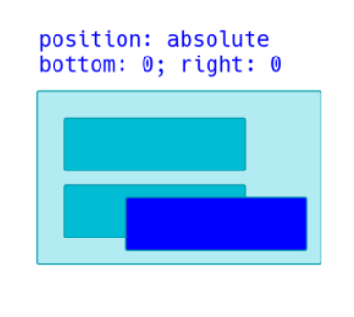
Absolute
›The element is removed from the flow of the document and other elements will behave as if it’s not even there whilst all the other positional properties will work on it.

Slide 9
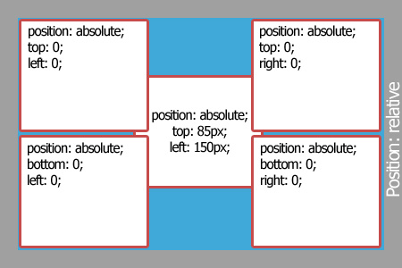
Absolute

Slide 10
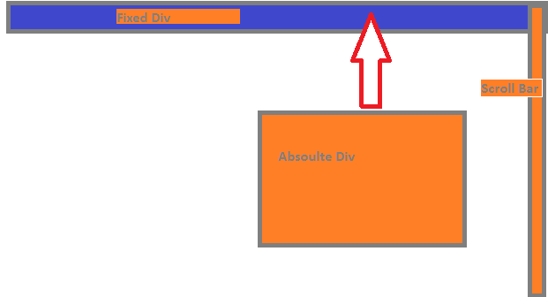
Fixed
›the element is removed from the flow of the document like absolutely positioned elements. In fact they behave almost the same, only fixed positioned elements are always relative to the document, not any particular parent, and are unaffected by scrolling.

Slide 11
Web Layout

Slide 12
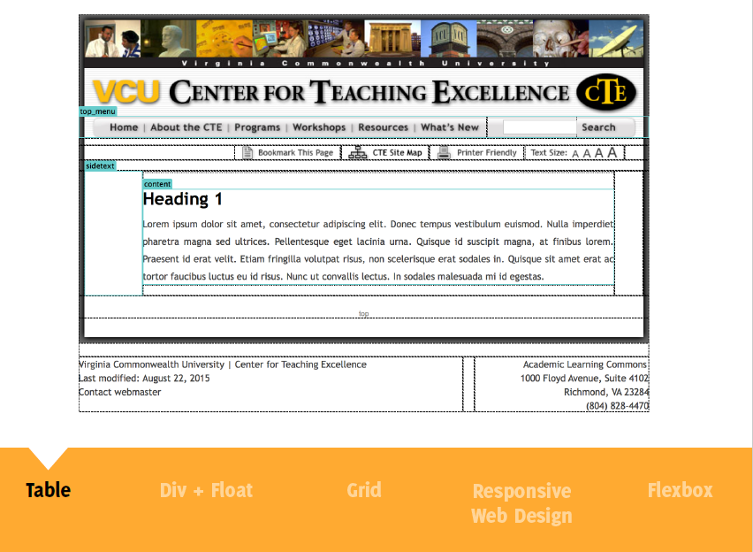

Slide 13
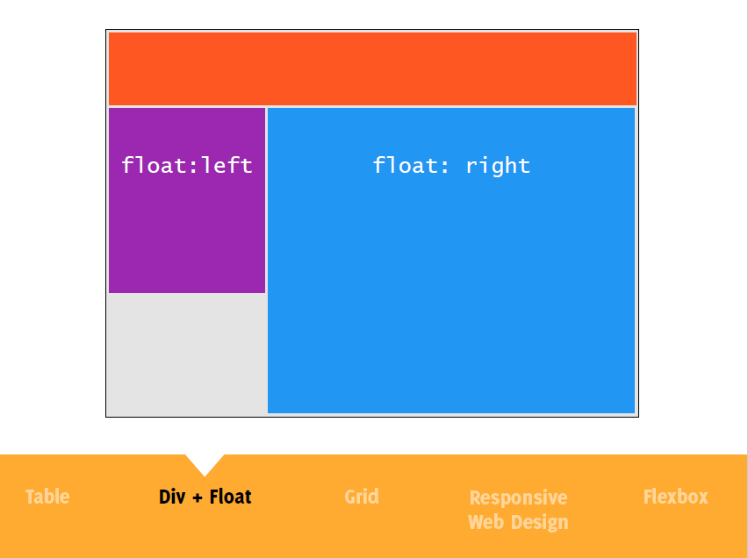

Slide 14
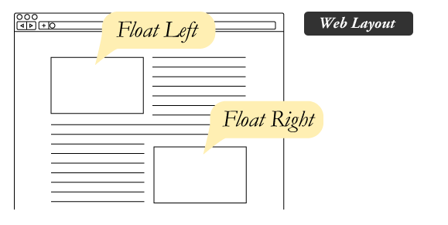
Float
›Float is a CSS positioning property. To understand its purpose and origin, we can look to print design. In a print layout, images may be set into the page such that text wraps around them as needed. This is commonly and appropriately called "text wrap". Here is an example of that.

Slide 15
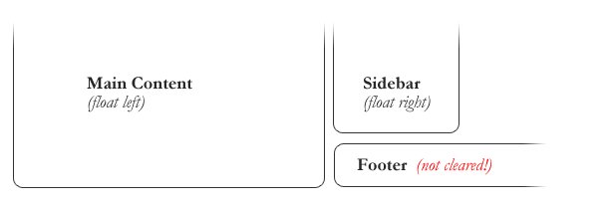
Clearing the Float
›Float's sister property is clear. An element that has the clear property set on it will not move up adjacent to the float like the float desires , but will move itself down past the float. Again an illustration probably does more good than words do.

Slide 16
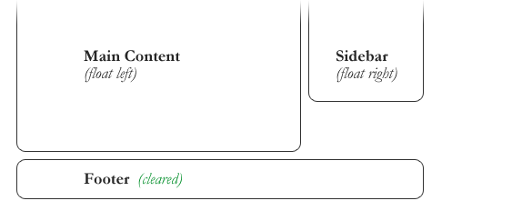
Clearing the Float
›Float's sister property is clear. An element that has the clear property set on it will not move up adjacent to the float like the float desires , but will move itself down past the float. Again an illustration probably does more good than words do.

Slide 17
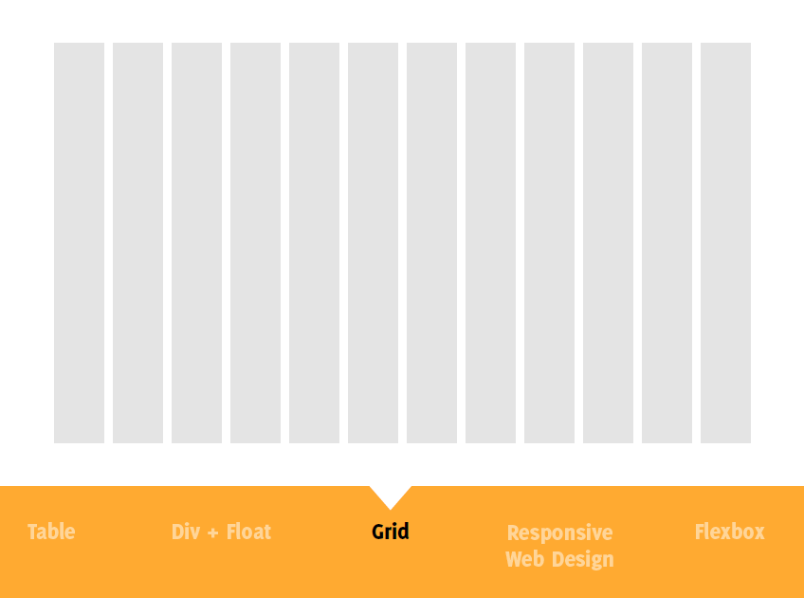

Slide 18
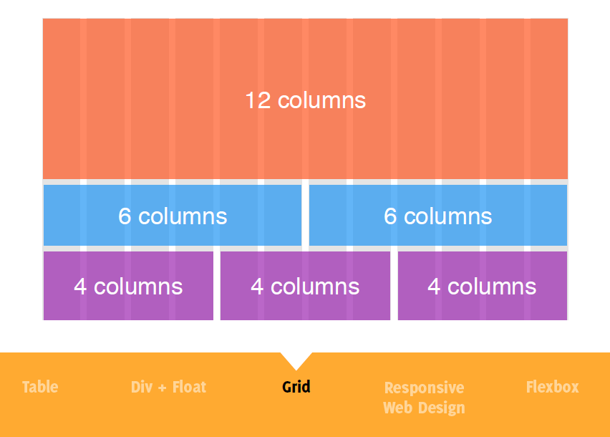

Slide 19


Slide 20


Slide 21
Bootstrap
Build responsive, mobile-first projects on the web with the world's most popular front-end component library.
Bootstrap is an open source toolkit for developing with HTML, CSS, and JS. Quickly prototype your ideas or build your entire app, responsive grid system, extensive prebuilt components, and powerful plugins built on jQuery.

Slide 22
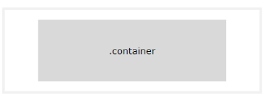
Bootstrap Grid
Containers are the most basic layout element in Bootstrap and are required when using our default grid system

Slide 23
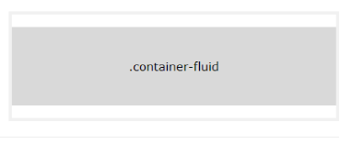
Bootstrap Grid
Use .container-fluid for a full width container, spanning the entire width of the viewport.

Slide 24
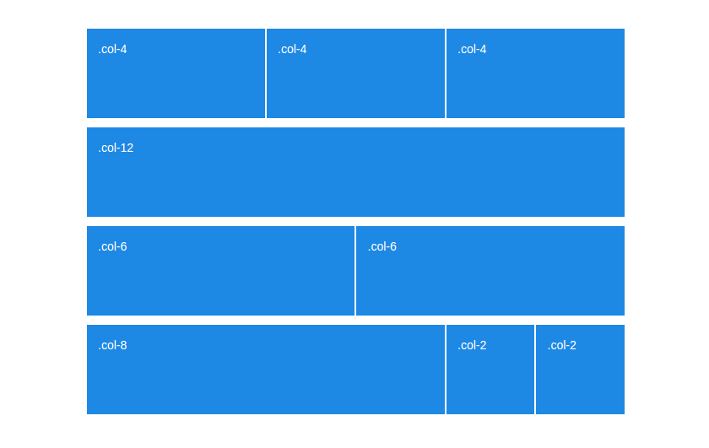
Bootstrap Grid

Slide 25


